Slide 1
Water effect
Advanced Graphics Programming

Slide 2
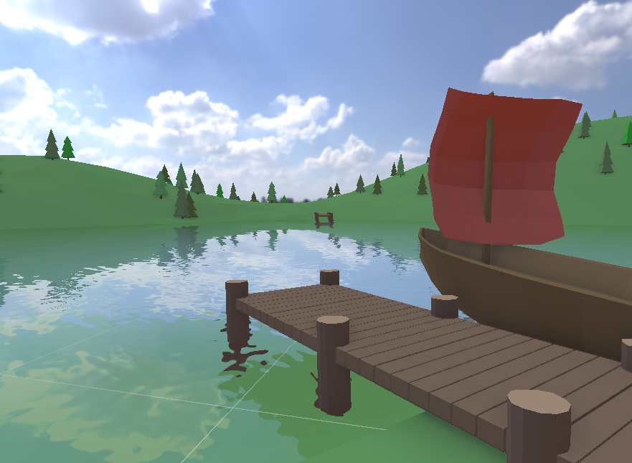
Water effect
Simulation of water
Refraction
Reflection
Distortion
Steps
Refraction pass
Render scene to texture
Geometry below the water plane (using clip plane)
Reflection pass
Render scene to texture
Geometry above the water plane (using clip plane)
Water pass
Distortion
Fresnel
Tint

Slide 3
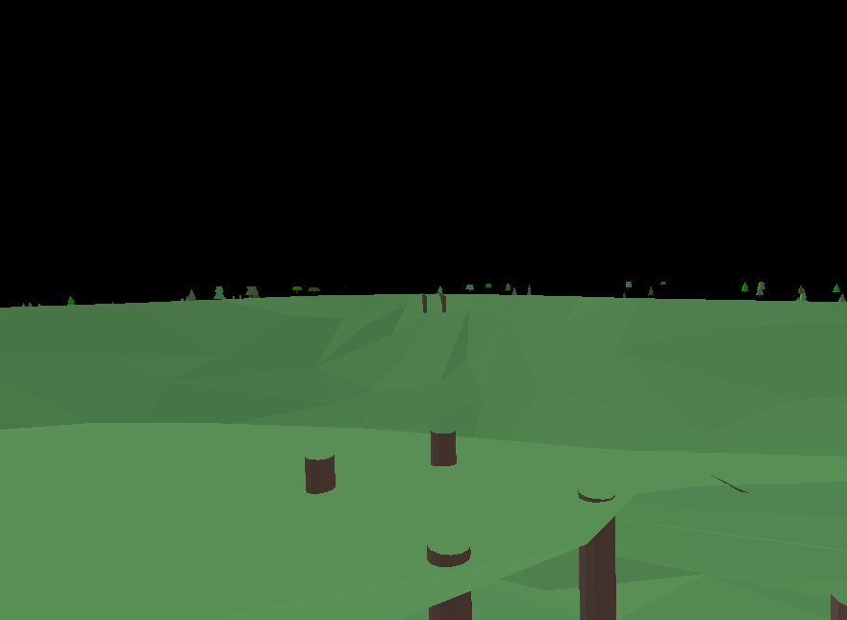
Refraction pass
Simulation of water
Refraction
Reflection
Distortion
Steps
Refraction pass
Render scene to texture
Geometry below the water plane (using clip plane)
Reflection pass
Render scene to texture
Geometry above the water plane (using clip plane)
Water pass
Distortion
Fresnel
Tint

Slide 4
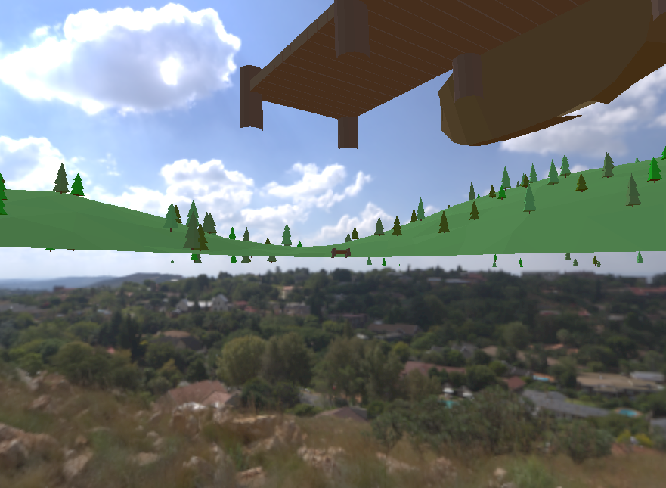
Reflection pass
Simulation of water
Refraction
Reflection
Distortion
Steps
Refraction pass
Render scene to texture
Geometry below the water plane (using clip plane)
Reflection pass
Render scene to texture
Geometry above the water plane (using clip plane)
Water pass
Distortion
Fresnel
Tint

Slide 5
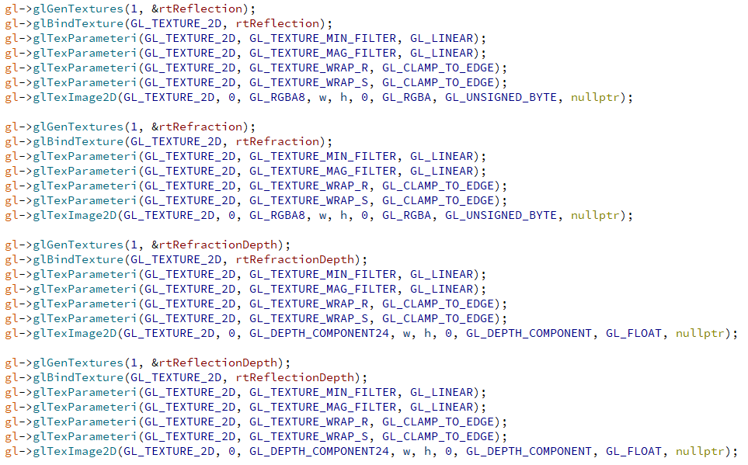
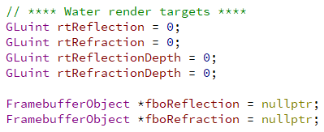
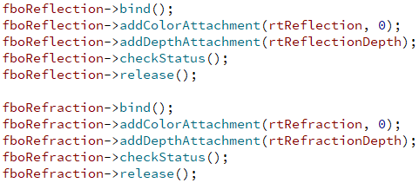
Code: Creation of textures and framebuffer objects
We create 4 empty textures
We need 4 textures and 2 FBOs
We attach them to 2 FBOs

Slide 6
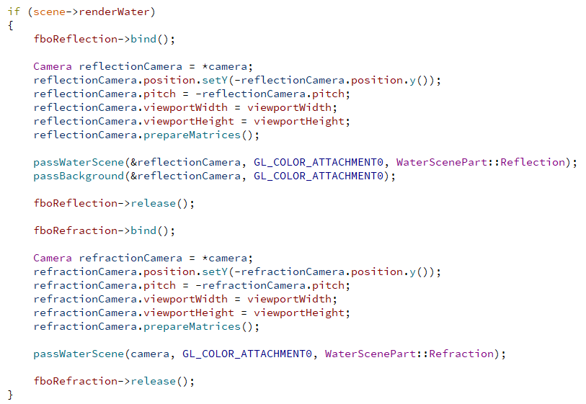
Code: Rendering clipped scene to reflection and refraction textures
Reflection
Bind FBO
Configure camera
Render scene
Render skybox
Release FBO
Refraction
Bind FBO
Configure camera
Render scene
Release FBO

Slide 7
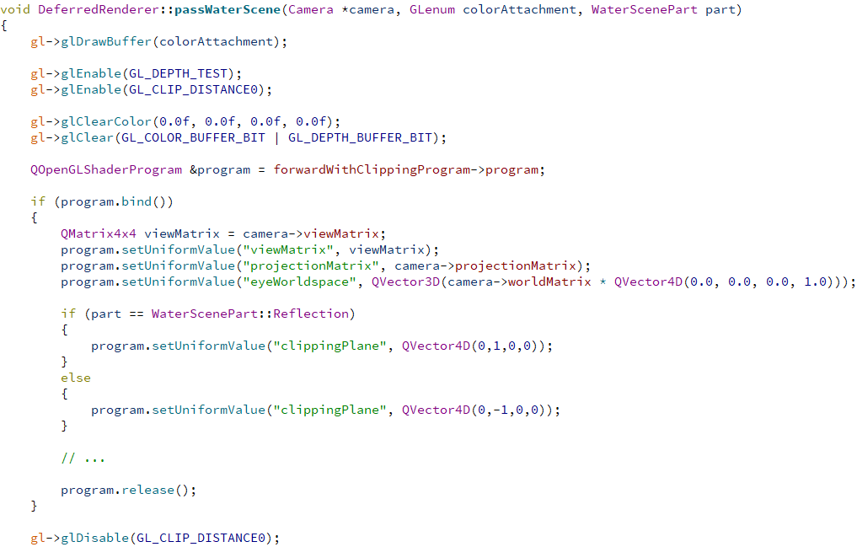
Code: Rendering scene specifying the water clip plane
Enable clipping plane 0
With this, we will clip some extra geometry within the frustum in the vertex shader.
Send a clipping plane to the shader
Here it is hardcoded. I’m assuming water as an horizontal plane (in XZ) at height 0.
Depending on the pass (refraction or reflection), the plane normal will be oriented towards Y or towards -Y.
Disable clipping plane 0

Slide 8
Code: Using GLSL gl_ClipDistance to clip some geometry
In the vertex shader...
Indicate, using gl_ClipDistance[0] (it was enabled from OpenGL), the distance from the vertex to the water plane.
We use the equation of the plane
Ax + By + Cz + D = 0
Can be solved with a simple dot product
clippingPlane is a uniform we sent from OpenGL with A, B, C, and D (plane normal and distance from the origin in world coordinates.
positionWorldspace is the position of the vertex in world coordinates.
All vertices/geometry at a negative clipping distance (i.e. in the negative half space of the water plane) will be clipped.

Slide 9
The two textures with the clipped scene
Refraction texture
Reflection texture

Slide 10
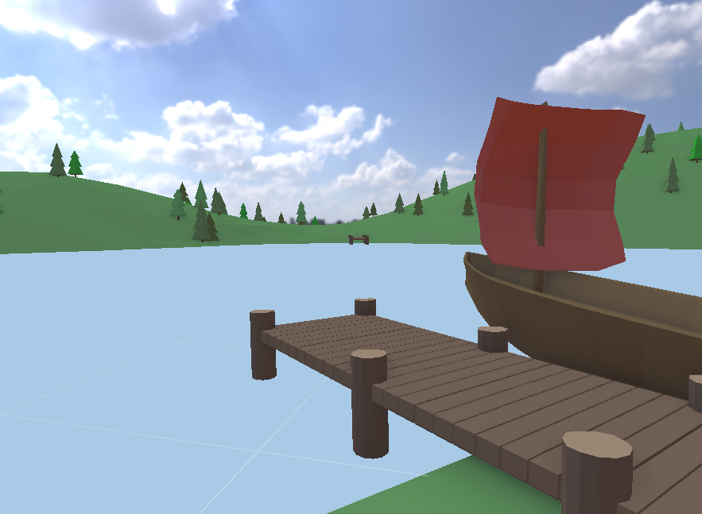
Water plane pass
Simulation of water
Refraction
Reflection
Distortion
Steps
Refraction pass
Render scene to texture
Geometry below the water plane (using clip plane)
Reflection pass
Render scene to texture
Geometry above the water plane (using clip plane)
Water pass
Distortion
Fresnel
Tint

Slide 11
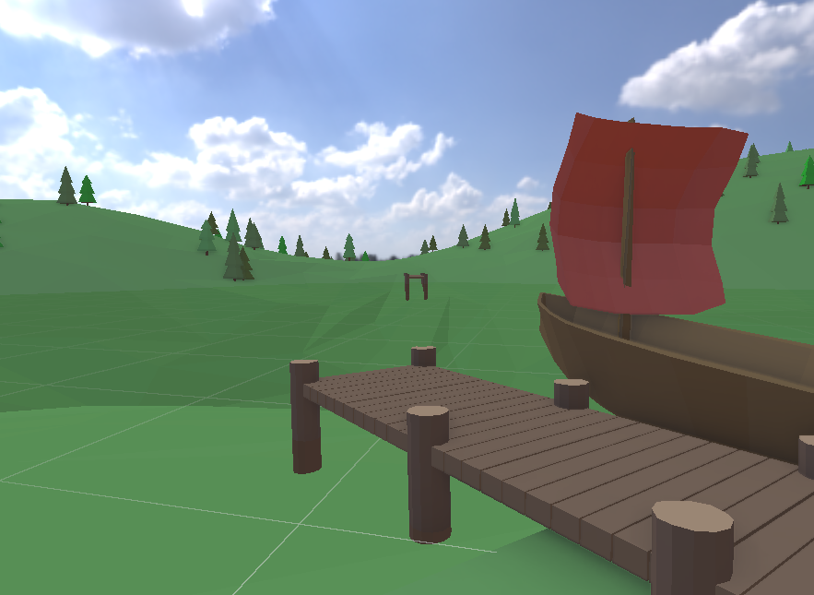
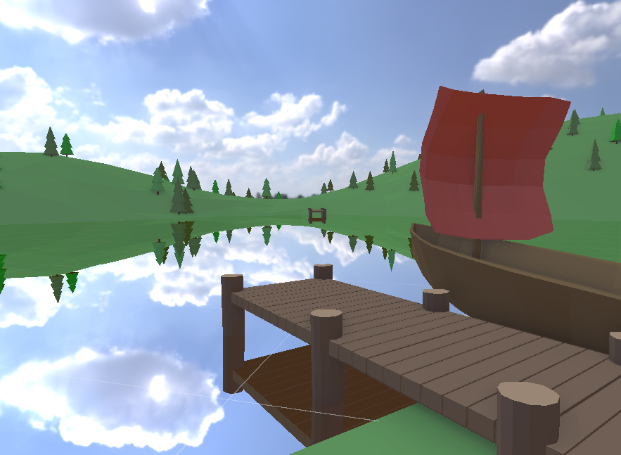
We can overlay the refraction and reflection textures on the scene

Slide 12
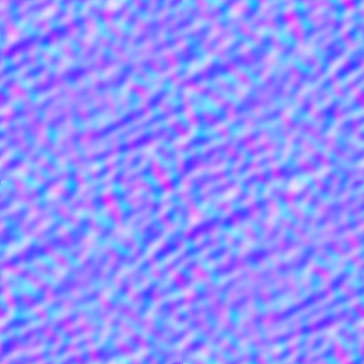
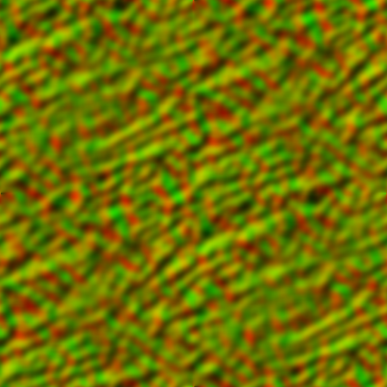
Normals and dudv maps
With some textures, we can fake the water distortion
Normals give us the orientation of the surface (used for lighting)
Dudv map give us the derivatives of the normal map (used for distorting the refraction and reflection textures)
Normal map
Dudv map

Slide 13
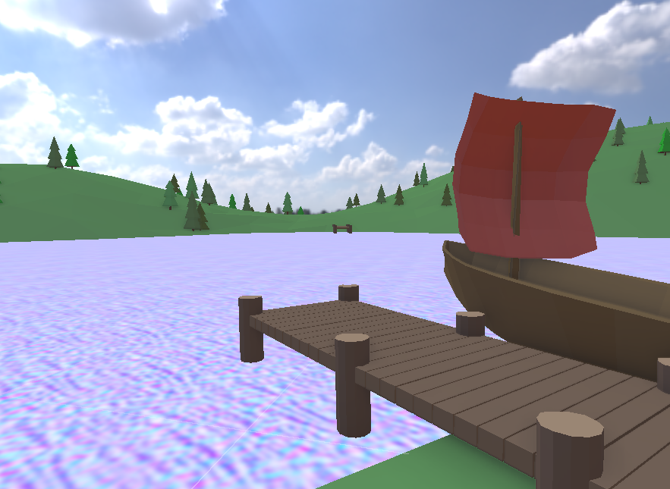
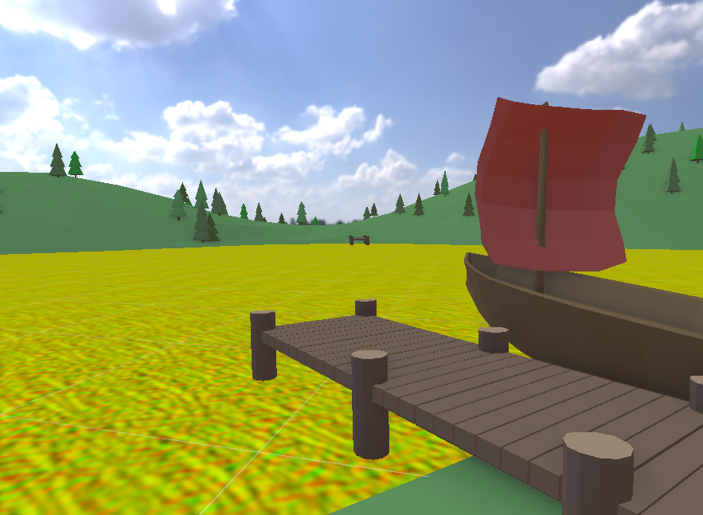
Normals and dudv maps on the water plane
We can map these textures to the water plane
Using the its x and z world coordinates

Slide 14
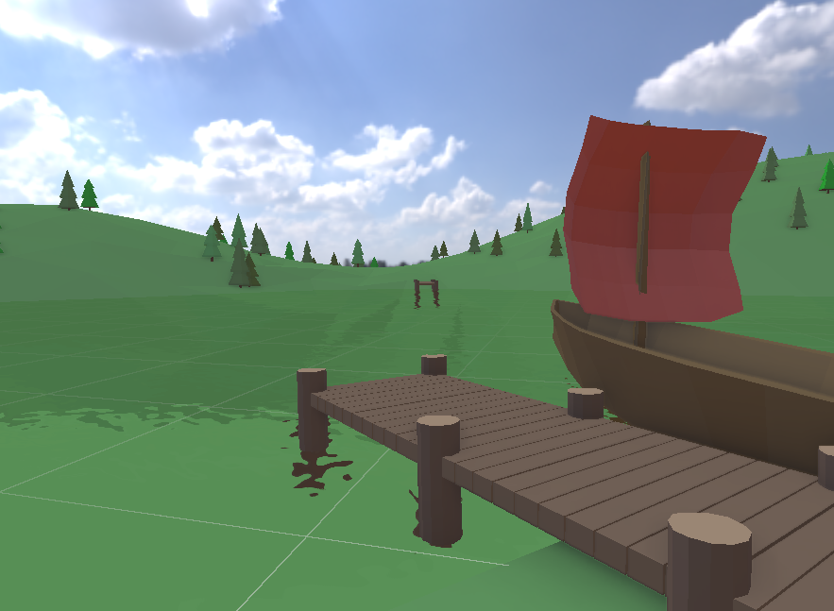

Using the dudv map to distort the reflection and refraction textures

Slide 15
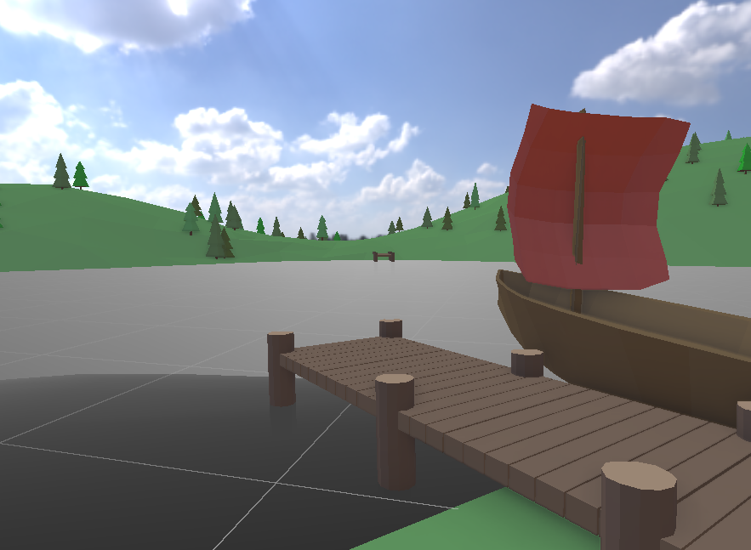

Slide 16
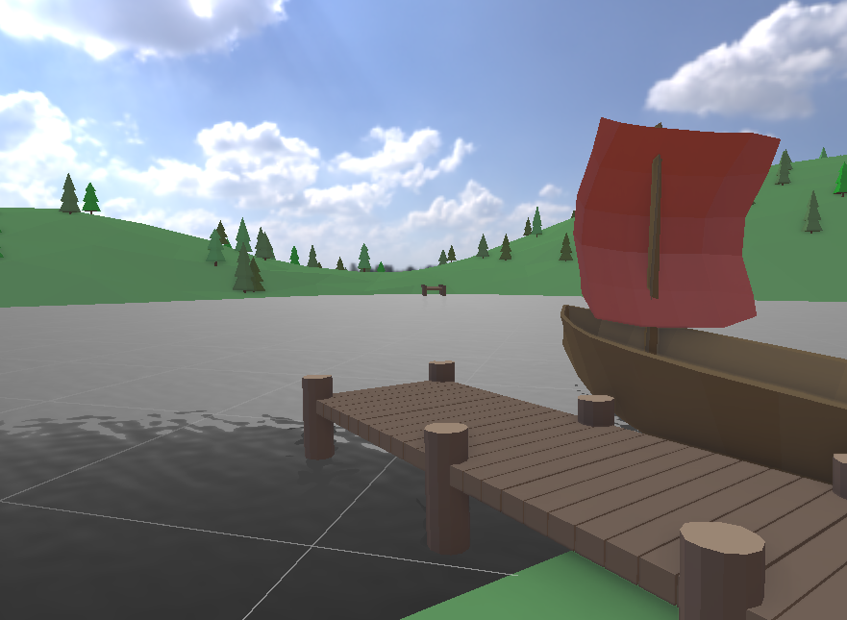

Slide 17
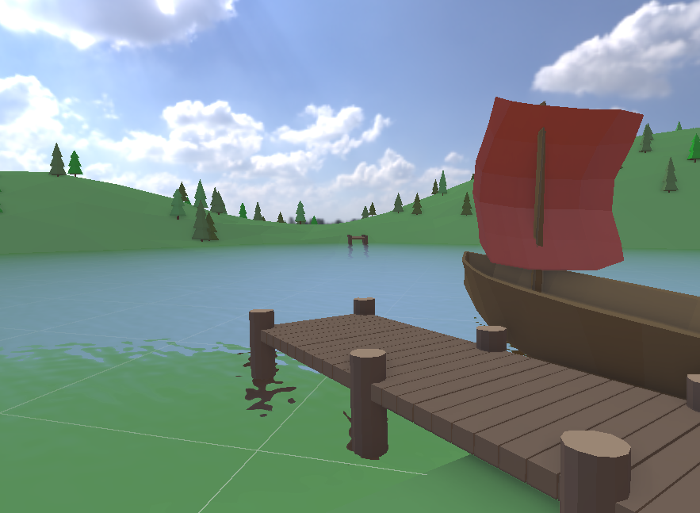

Slide 19
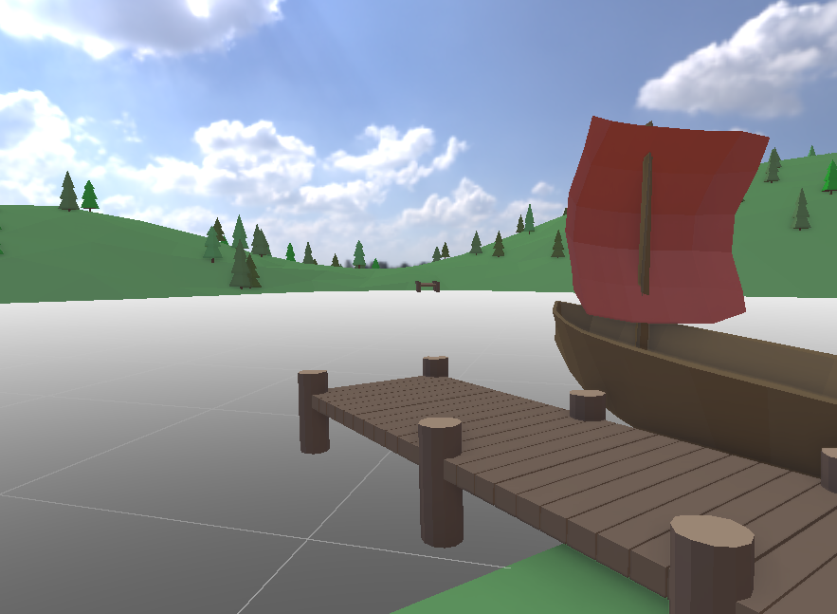
Using the Fresnel term to mix refraction and reflection colors

Slide 20
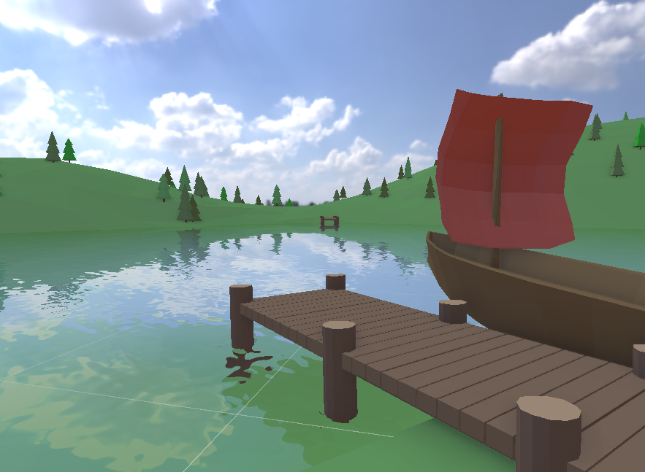
Result

Slide 21
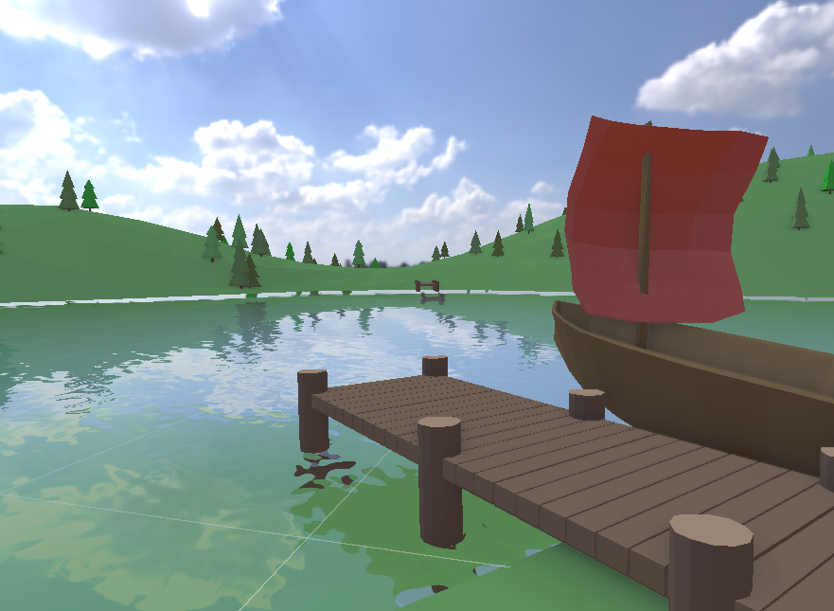
Artifacts
Because of distortion, we can access invalid positions in the refraction and reflection textures.
Sky where there should be ground
Ground where there should be wood

Slide 22
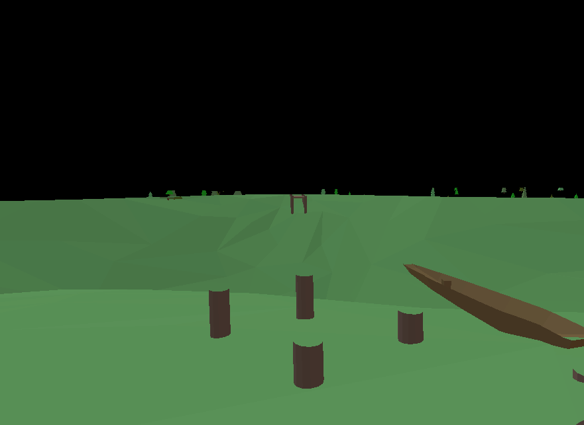
Artifacts
Solution: Render geometry a little beyond the clip plane
More into the water for the reflection
More into the air for the refraction

Slide 23
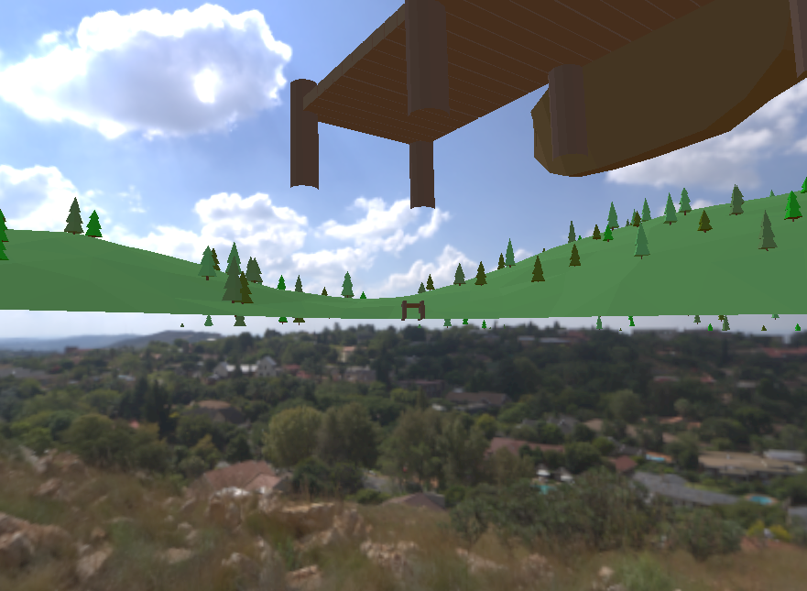
Artifacts
Solution: Render geometry a little beyond the clip plane
More into the water for the reflection
More into the air for the refraction

Slide 24
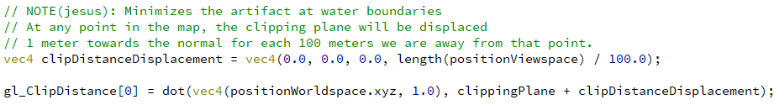
Artifacts
Clipping distance before...
Solution: Render geometry a little beyond the clip plane
More into the water for the reflection
More into the air for the refraction
Clipping distance before...
Clipping distance after

Slide 25
Result

Slide 26
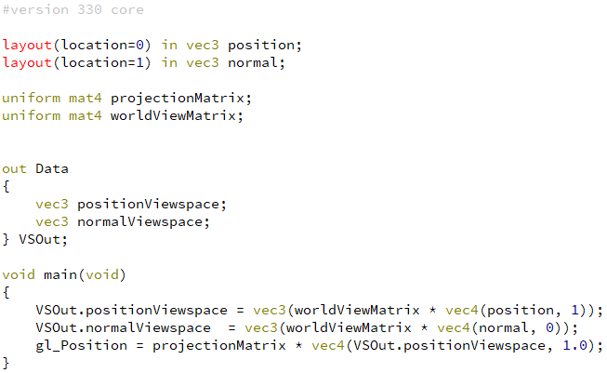
Water effect vertex shader

Slide 27
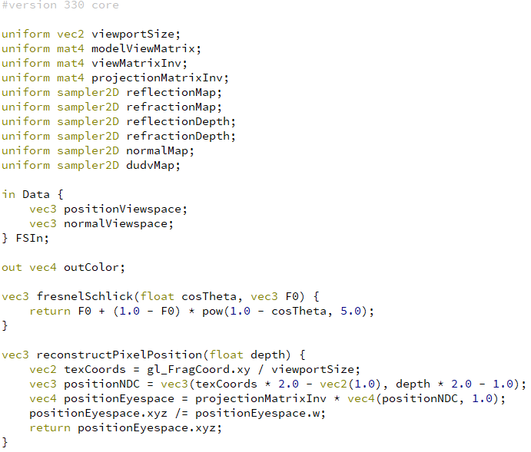
Water effect fragment shader

Slide 28
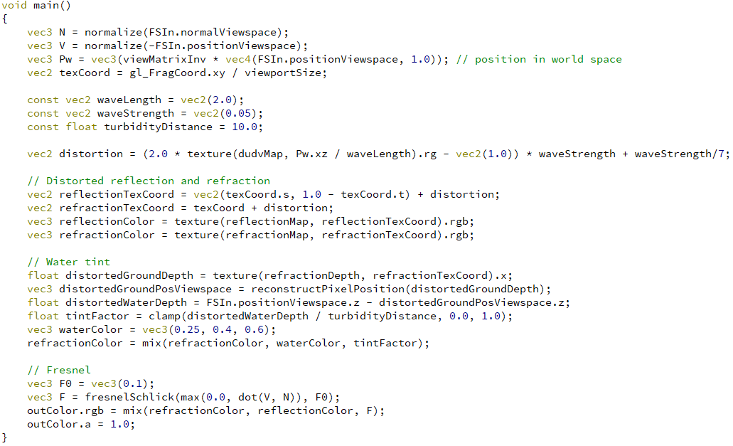
Water effect fragment shader

Slide 29
Performance improvements
Don’t perform any steps if the water plane is not within the frustum
Wastes precious time
Geometry of the refraction / reflection textures
Choose a subset of the scene
Probably design-guided
Quality of the refraction / reflection textures
Distorted - no need for much detail
Low viewport resolution
Low-poly geometry
Low-quality shading

Slide 30
References
Water effect using GLSL (Youtube videos):
https://www.youtube.com/watch?v=HusvGeEDU_U&list=PLRIWtICgwaX23jiqVByUs0bqhnalNTNZh
Shader based water effects paper
http://cdn.imgtec.com/sdk-documentation/Shader+Based+Water+Effects.Whitepaper.pdf

Slide 31

Questions?

